Slide 1
INDUSTRIAL ELECTRONICS & CONTROL DRIVERS
INTRODUCTION TO THYRISTOR FAMILY

Slide 2
SCR
SCR stands for Silicon Controlled Rectifier.
It is four layer, three terminal device.
It belongs to thyristor family.
SCR works on the principle of two transistor analogy.

Slide 3
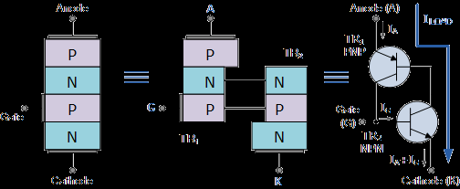
Circuit Diagram of SCR

Slide 4
Working of SCR
The two transistor equivalent circuit shows that the collector current of the NPN transistor TR₂ feeds directly into the base of the PNP transistor TR₁, while the collector current of TR₁ feeds into the base of TR₂.
These two inter-connected transistors rely upon each other for conduction as each transistor gets its base-emitter current from the other’s collector-emitter current.
So until one of the transistors is given some base current nothing can happen even if an Anode-to-Cathode voltage is present.

Slide 5
Working of SCR
This is an important negative characteristic of the thyristor, as Thyristors can be unintentionally triggered into conduction by a reverse over-voltage as well as high temperature or a rapidly rising dv/dt voltage such as a spike.

Slide 6
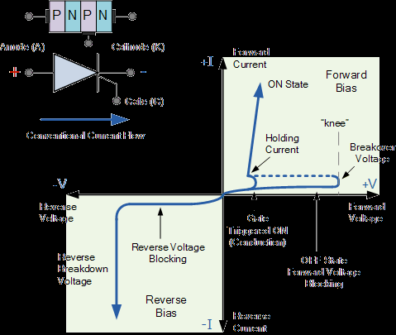
VI Characteristics of SCR

Slide 7
Working of SCR
When the thyristors Anode terminal is negative with respect to the Cathode, the centre N-P junction is forward biased, but the two outer P-N junctions are reversed biased and it behaves very much like an ordinary diode.
Therefore a thyristor blocks the flow of reverse current until at some high voltage level the breakdown voltage point of the two outer junctions is exceeded and the thyristor conducts without the application of a Gate signal.

Slide 8
VI Characteristics of SCR

Slide 9
Description of VI Characteristics
Once the thyristor has been turned “ON” and is passing current in the forward direction (anode positive), the gate signal looses all control due to the regenerative latching action of the two internal transistors.
The application of any gate signals or pulses after regeneration is initiated will have no effect at all because the thyristor is already conducting and fully-ON.

Slide 10
Description of VI Characteristics
Unlike the transistor, the SCR can not be biased to stay within some active region along a load line between its blocking and saturation states. The magnitude and duration of the gate “turn-on” pulse has little effect on the operation of the device since conduction is controlled internally.
Then applying a momentary gate pulse to the device is enough to cause it to conduct and will remain permanently “ON” even if the gate signal is completely removed.

Slide 11
Description of VI Characteristics
Therefore the thyristor can also be thought of as a Bistable Latch having two stable states “OFF” or “ON”. This is because with no gate signal applied, a silicon controlled rectifier blocks current in both directions of an AC waveform, and once it is triggered into conduction, the regenerative latching action means that it cannot be turned “OFF” again just by using its Gate.

Slide 12
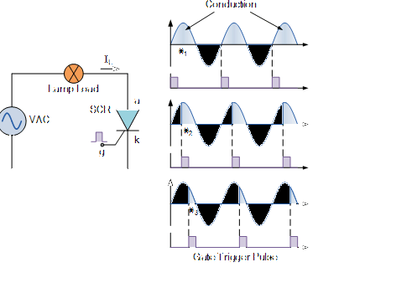
Thyristor Phase Control

Slide 13
Working of Phase Control
At the start of each positive half-cycle the SCR is “OFF”. On the application of the gate pulse triggers the SCR into conduction and remains fully latched “ON” for the duration of the positive cycle. If the thyristor is triggered at the beginning of the half-cycle ( θ = 0º ), the load (a lamp) will be “ON” for the full positive cycle of the AC waveform (half-wave rectified AC) at a high average voltage of 0.318 x Vp.

Slide 14
Working of Phase Control
As the application of the gate trigger pulse increases along the half cycle ( θ = 0º to 90º ), the lamp is illuminated for less time and the average voltage delivered to the lamp will also be proportionally less reducing its brightness.
Then we can use a silicon controlled rectifier as an AC light dimmer as well as in a variety of other AC power applications such as: AC motor-speed control, temperature control systems and power regulator circuits, etc.

Slide 15
Working of Phase Control
Such devices include “Gate Turn-OFF Thyristors” (GTO), “Static Induction Thyristors” (SITH), “MOS Controlled Thyristors” (MCT), “Silicon Controlled Switch” (SCS), “Triode Thyristors” (TRIAC) and “Light Activated Thyristors” (LASCR) to name a few, with all these devices available in a variety of voltage and current ratings making them attractive for use in applications at very high power levels.

Slide 16
Thyristor Summary
Silicon Controlled Rectifiers known commonly as Thyristors are three-junction PNPN semiconductor devices which can be regarded as two inter-connected transistors that can be used in the switching of heavy electrical loads.
They can be latched-“ON” by a single pulse of positive current applied to their Gate terminal and will remain “ON” indefinitely until the Anode to Cathode current falls below their minimum latching level.

Slide 17
Static Characteristics of Thyristor
Thyristors are semiconductor devices that can operate only in the switching mode.
Thyristor are current operated devices, a small Gate current controls a larger Anode current.
Conducts current only when forward biased and triggering current applied to the Gate.
The thyristor acts like a rectifying diode once it is triggered “ON”.

Slide 18
Static Characteristics of Thyristor
The thyristor acts like a rectifying diode once it is triggered “ON”.
Anode current must be greater than holding current to maintain conduction.
Blocks current flow when reverse biased, no matter if Gate current is applied.
Once triggered “ON”, will be latched “ON” conducting even when a gate current is no longer applied providing Anode current is above latching current.

Slide 19
Applications of Thyristors
Thyristors are high speed switches that can be used to replace electromechanical relays in many circuits as they have no moving parts, no contact arcing or suffer from corrosion or dirt.
But in addition to simply switching large currents “ON” and “OFF”, thyristors can be made to control the mean value of an AC load current without dissipating large amounts of power.
A good example of thyristor power control is in the control of electric lighting, heaters and motor speed.

Slide 20
THANKS

