Slide 1
INDUSTRIAL ELECTRONICS & CONTROL DRIVERS
INTRODUCTION TO
CHOPPERS

Slide 2
What is Chopper
A chopper uses high speed to connect and disconnect from a source load. A fixed DC voltage is applied intermittently to the source load by continuously triggering the power switch ON/OFF. The period of time for which the power switch stays ON or OFF is referred to as the chopper’s ON and OFF state times, respectively.
Choppers are mostly applied in electric cars, conversion of wind and solar energy, and DC motor regulators.

Slide 3
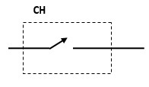
Symbol of Chopper

Slide 4
Type A Chopper or First–Quadrant Chopper
This type of chopper is shown in the figure. It is known as first-quadrant chopper or type A chopper. When the chopper is on, v₀ ₌ V_{S} as a result and the current flows in the direction of the load.
But when the chopper is off v₀ is zero but I₀ continues to flow in the same direction through the freewheeling diode FD, thus average value of voltage and current say V₀ and I₀ will be always positive.

Slide 5
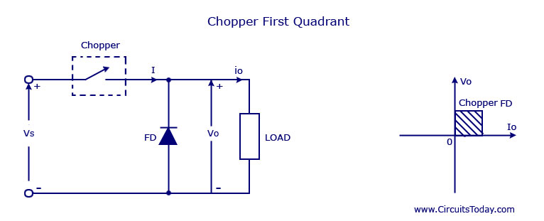
Type A Chopper or First–Quadrant Chopper

Slide 6
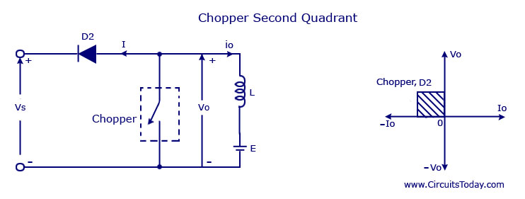
Class B Chopper 2nd Quadrant Chopper

Slide 7
Working of class B Chopper
In type B or second quadrant chopper the load must always contain a dc source E . When the chopper is on, v₀ is zero but the load voltage E drives the current through the inductor L and the chopper, L stores the energy during the time T_{on} of the chopper .
When the chopper is off , v₀ =( E+ L . di/dt) will be more than the source voltage V_{s} .

Slide 8
Working of class B Chopper
Because of this the diode D2 will be forward biased and begins conducting and hence the power starts flowing to the source. No matter the chopper is on or off the current I₀ will be flowing out of the load and is treated negative .
Since V_{O} is positive and the current I₀ is negative , the direction of power flow will be from load to source. The load voltage V₀ = (E+L .di/dt ) will be more than the voltage V_{s} so the type B chopper is also known as a step up chopper .

Slide 9
Type -C chopper or Two-quadrant type-A Chopper
Type C chopper is obtained by connecting type –A and type –B choppers in parallel. We will always get a positive output voltage V₀ as the freewheeling diode FD is present across the load.
When the chopper is on the freewheeling diode starts conducting and the output voltage v₀ will be equal to V_{s} . The direction of the load current i₀ will be reversed.

Slide 10
Working
The current i₀ will be flowing towards the source and it will be positive regardless the chopper is on or the FD conducts. The load current will be negative if the chopper is or the diode D2 conducts.
We can say the chopper and FD operate together as type-A chopper in first quadrant. In the second quadrant, the chopper and D2 will operate together as type –B chopper.

Slide 11
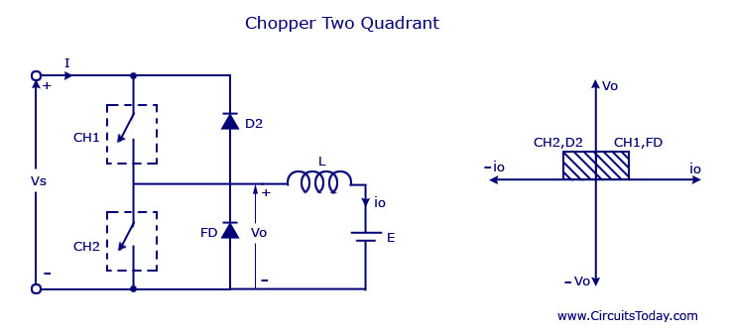
Working

Slide 12
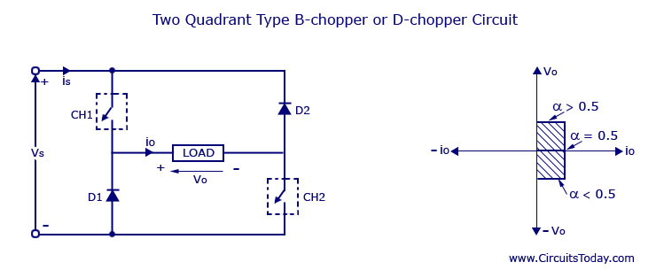
Type D Chopper or Two-Quadrant Type –B Chopper

Slide 13
Working
The circuit diagram of the type D chopper is shown in the above figure. When the two choppers are on the output voltage v₀ will be equal to V_{s} . When v₀ = – V_{s} the two choppers will be off but both the diodes D1 and D2 will startconducting.

Slide 14
Working
V₀ the average output voltage will be positive when the choppers turn-on the time T_{on} will be more than the turn off time T_{off} its shown in the wave form below. As the diodes and choppers conduct current only in one direction the direction of load current will be always positive.

Slide 15
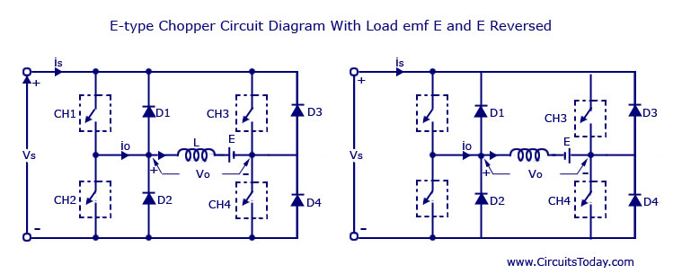
Type –E chopper or the Fourth-Quadrant Chopper

Slide 16
Working
During the first quadrant operation the chopper CH4 will be on . Chopper CH3 will be off and CH1 will be operated. AS the CH1 and CH4 is on the load voltage v₀ will be equal to the source voltage V_{s} and the load current i₀ will begin to flow . v₀ and i₀ will be positive as the first quadrant operation is taking place.

Slide 17
Working
As soon as the chopper CH1 is turned off, the positive current freewheels through CH4 and the diode D2 . The type E chopper acts as a step- down chopper in the first quadrant.

Slide 18
Working
In this case the chopper CH2 will be operational and the other three are kept off. As CH2 is on negative current will starts flowing through the inductor L . CH2 ,E and D4. Energy is stored in the inductor L as the chopper CH2 is on

Slide 19
Working
When CH2 is off the current will be fed back to the source through the diodes D1 and D4. Here (E+L.di/dt) will be more than the source voltage V_{s} . In second quadrant the chopper will act as a step-up chopper as the power is fed back from load to source

Slide 20
Working
In third quadrant operation CH1 will be kept off , CH2 will be on and CH3 is operated. For this quadrant working the polarity of the load should be reversed. As the chopper CH3 is on, the load gets connected to the source V_{s} and v₀ and i₀ will be negative and the third quadrant operation will takes place. This chopper acts as a step-down chopper

Slide 21
Working
CH4 will be operated and CH1, CH2 and CH3 will be off. When the chopper CH4 is turned on positive current starts to flow through CH4, D2 ,E and the inductor L will store energy.

Slide 22
Working
As the CH4 is turned off the current is feedback to the source through the diodes D2 and D3 , the operation will be in fourth quadrant as the load voltage is negative but the load current is positive. The chopper acts as a step up chopper as the power is fed back from load to source.

Slide 23
THANKS

